Slide 1
Forensics
Using Chainsaw to Identify Malicious Activity

Slide 2
Agenda
Chainsaw Overview
SIGMA Rules
Demo (/w Obsidian Project)

Slide 3

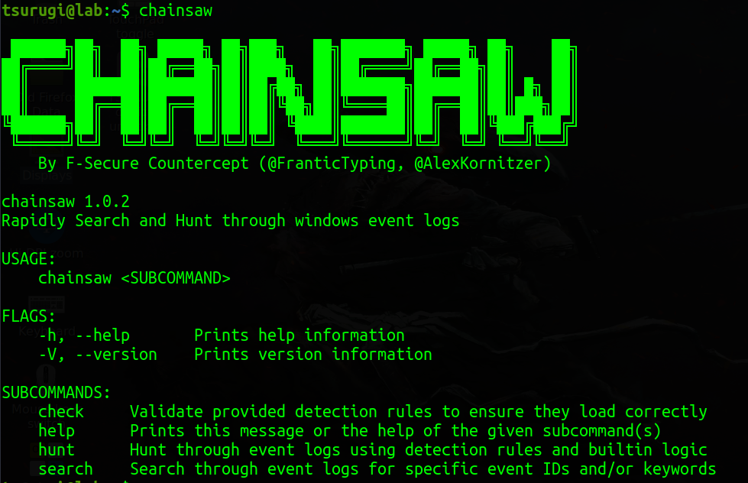
Chainsaw Overview
First-response capability to quickly identify threats via event logs
Command-line tool running Sigma rule detection logic
Can search by keyword, regex, or specific Event IDs
Can export data to TXT file or CSV for carving into spreadsheets

Slide 4
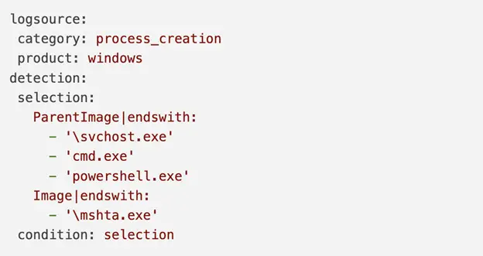
Sigma Rules
Generic signature format for SIEMs in YAML designed for Windows Event Logs
Is to Event Logs as Yara is to Malware
Developed by Florian Roth and Thomas Patzke
Intezer example, CSO Online

Slide 5


DEMO TIME

Slide 6
References
Chainsaw
WithSecure Labs: https://labs.withsecure.com/tools/chainsaw/
CounterCept GitHub: https://github.com/countercept/chainsaw
Sigma Rules
Ax Sharma, CSO Online: https://www.csoonline.com/article/3663691/sigma-rules-explained-when-and-how-to-use-them-to-log-events.html
Adam Swan, SOC Prime: https://socprime.com/blog/sigma-rules-the-beginners-guide/

